Slide 1
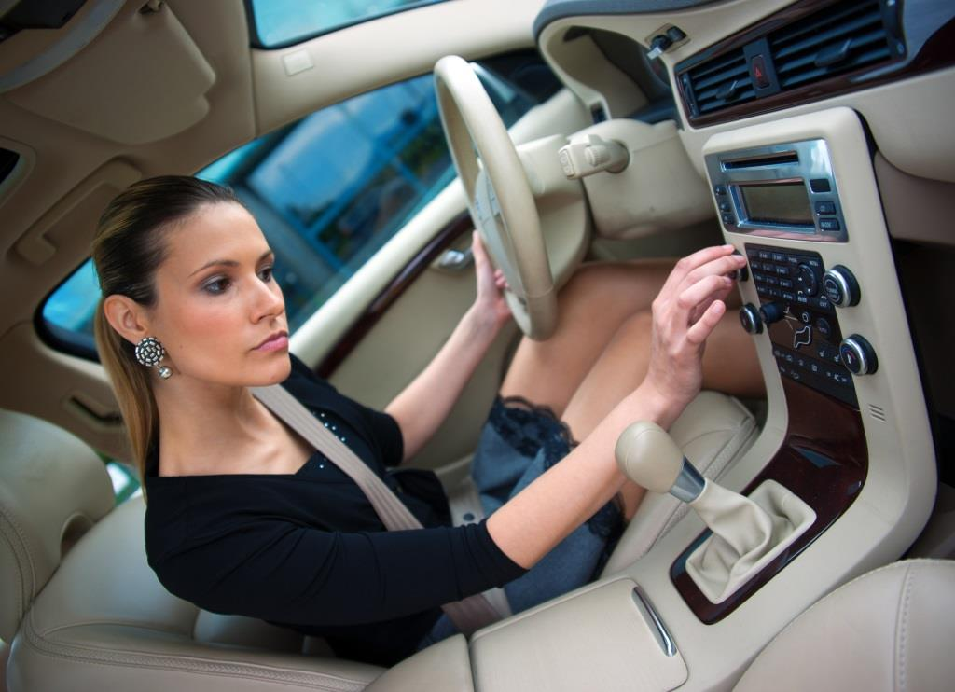

Penn Liberty Motors
Coming Soon!

Slide 2
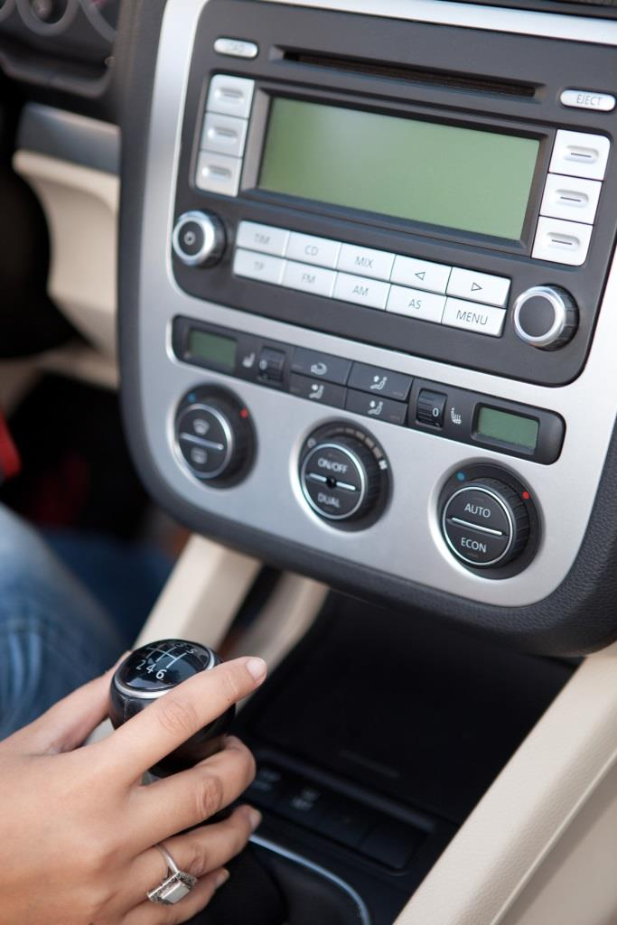
In-Car Voice and Stereo System
Pricing Information

Slide 3
State of the Art Digital Media
Communication
Entertainment
Fully Integrated
Voice Activated

Slide 4
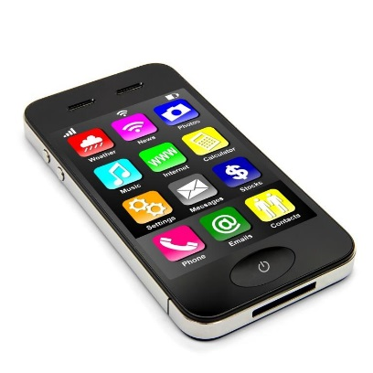
Integration
Mobile Phone
Digital Media Player
Upgradeable
Bluetooth Enabled
Smart Voice Recognition

Slide 5
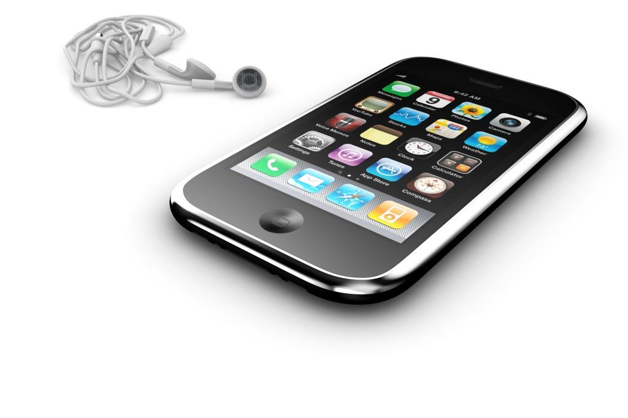
Mobile Phone Standard Features
Voice Activated
Hands-Free Calling
Uninterrupted Connection
Transfer Calls
Audible Text Messages

Slide 6
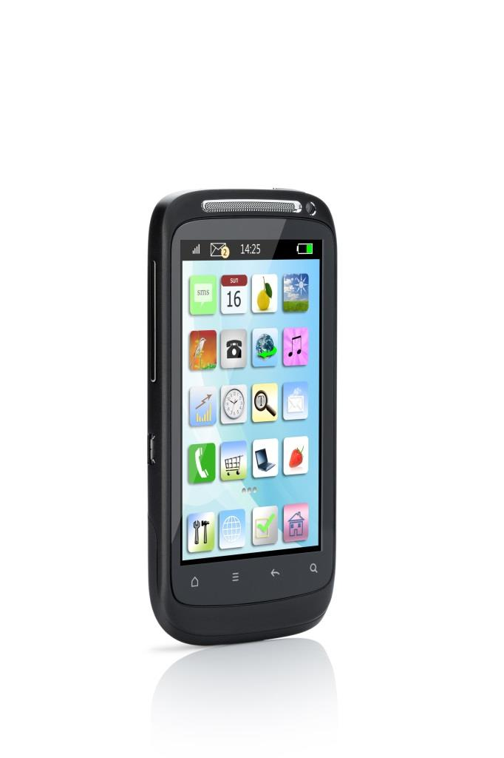
Mobile Phone Advanced Features
Caller ID
Call Waiting
Conference Calling
Call Log
Contact List

Slide 7

Digital Media Player Features
Supports Popular Players
Support Popular Formats
USB Device Charging
Audio Book Support

